Slide 1
Solar collector

Slide 2
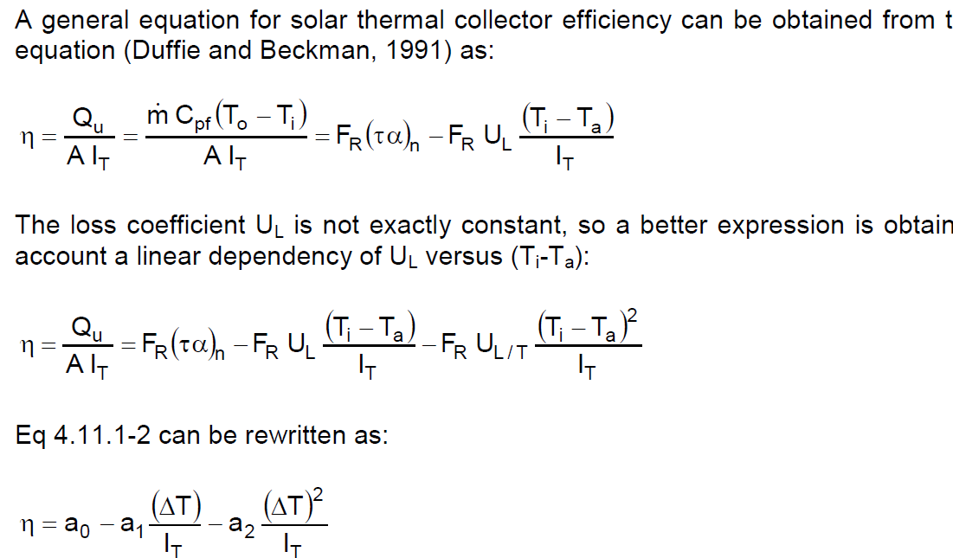
Trnsys Type1: flat plate collector (quadratic efficiency)
parameters a0,a1,a2
from collector tests (CEN,2001)
Determined for collector area = aperture area
In Europe usually determined for deltaT=Tav-Ta

Slide 3



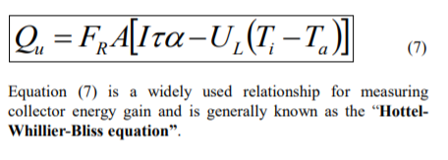
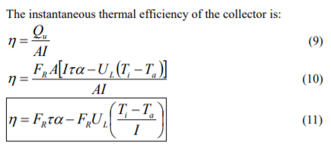
Heat Removal Factor
FR? Heat Removal Factor (cf Fabio Struckmann “Analysis of a Flat-plate Solar Collector”)
Rate of useful energy extracted by the collector (steady state):
= amount of heat carried away by collector fluid:
As it is difficult to define the collector average temp Tc in (4) =>
So, FR says which fraction of the maximum possible useful energy gain (when the whole collector is at Ti), is the actual useful energy gain (going to the collector fluid):

Slide 4
Heat Removal factor
FR=F’*F’’
with F’ is the collector fin efficiency factor (depends on geometry: diameter, distance between pipes,…)
Trnsys models with capacitance and #segments, use only F’ (derived from test data), so differential equation is with F’ instead of FR
F’’ depends on mass flow… (counts for dynamic behaviour…(?))

Slide 5
Trnsys Type1: corrections
Flow rate different from test
Collectors in series
Non normal solar incidence

Slide 6
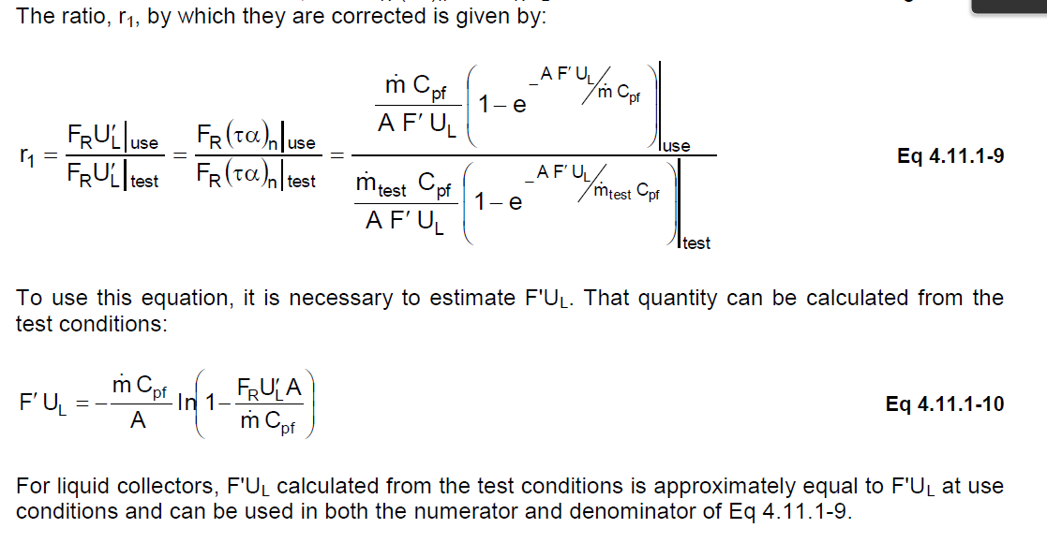
TRNSYS Type1: correction flow rate
=F’’ (in FR=F’*F’’)
This is correction of F’’,
so no correction on F’ in capacitance models…

Slide 7
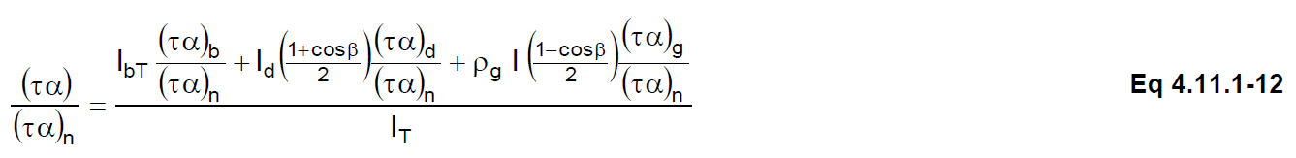
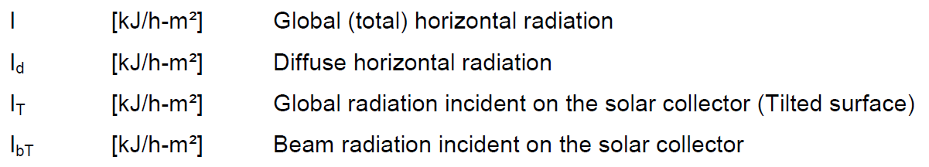
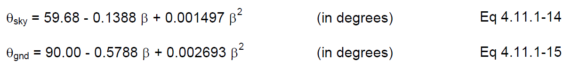
Trnsys Type1: correction non normal solar incidence
τα in test is for normal incidence (τα)n
τα for non-normal solar incidence should be used => a0 * (τα)/(τα)n
(τα)b/(τα)n = IAM for beam radiation
from tests,
supplied versus angle of incidence θ on collector
for tube collector different IAM for longitudinal and transversal direction
flat plate collector is assumed to be symmetrical (one direction is enough)
total IAM is product of IAM’s for different directions
(τα)d/(τα)n = IAM for diffuse radiation (sky diffuse, ground diffuse)
Determined based on equivalent incidence angle
Sky diffuse radiation on tilted surface
as a fraction of sky diffuse radiation on horizontal ok
Ground reflected radiation on tilted surface
as a fraction of beam + sky diffuse radiation on horizontal ok

Slide 8
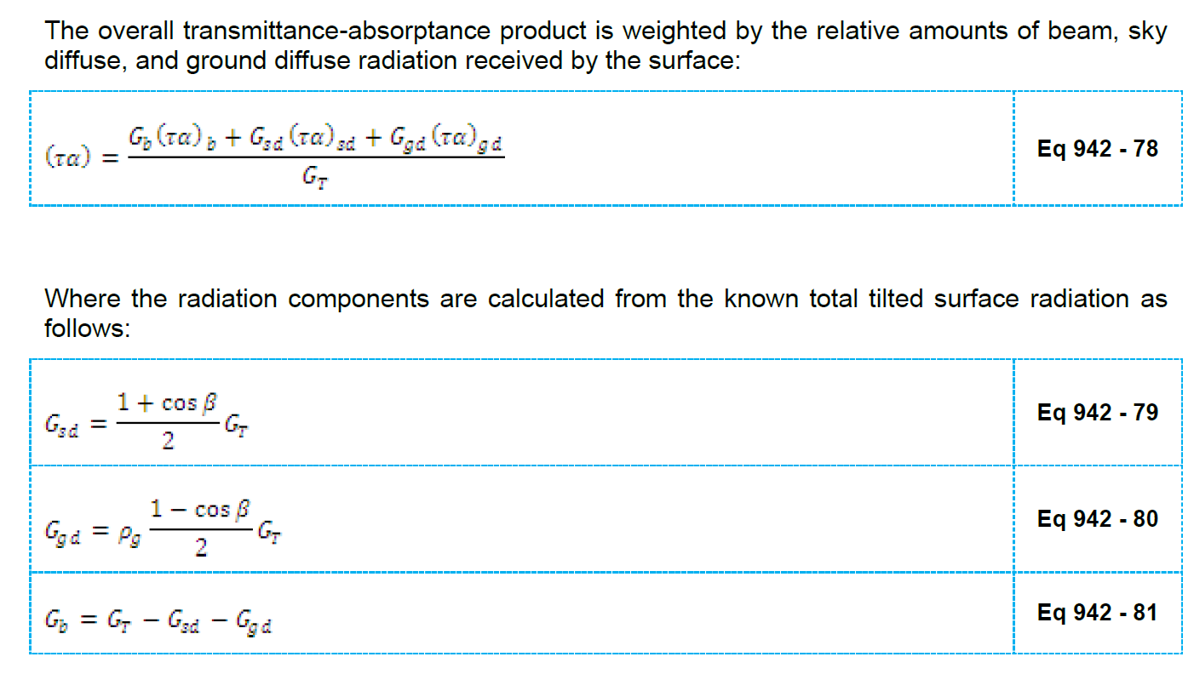
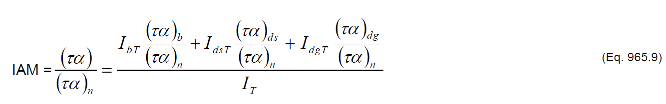
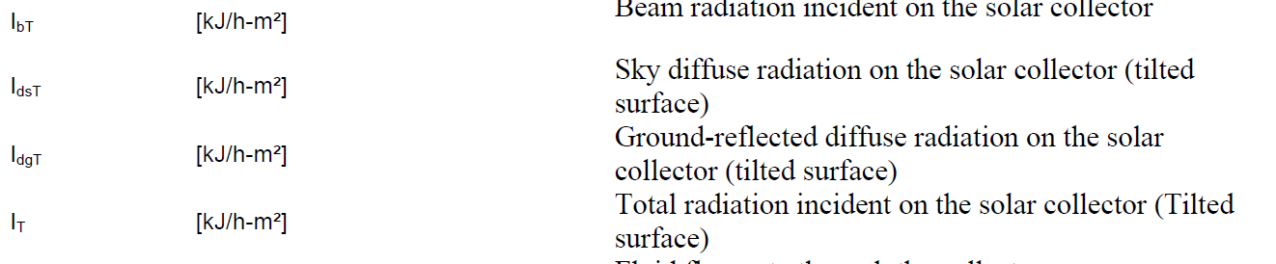
(τα)/(τα)n?
According to Type942 and type 965 resp.:
Should be diffuse radiation on horiz …

Slide 9
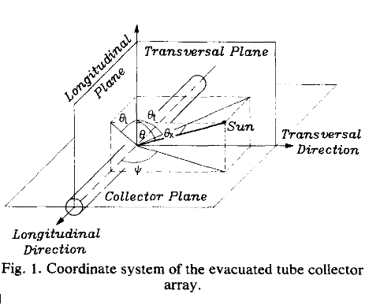
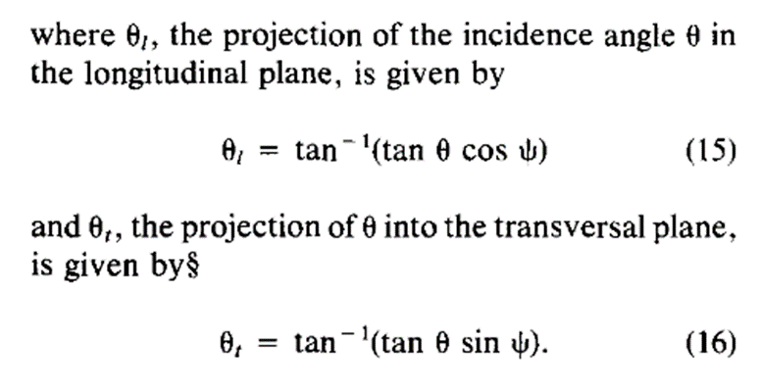
Incident angle in longitudinal and transversal direction
Cf Solar transmittance characteristics of evacuated tubular collectors with diffuse black collectors. P.-H. Theunissen, W.A. Beckman

Slide 10
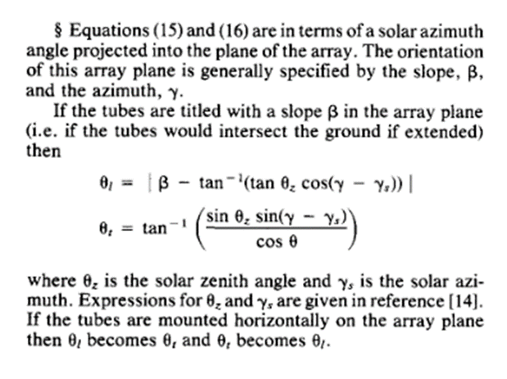
Incident angle in longitudinal and transversal direction
Cf Solar transmittance characteristics of evacuated tubular collectors with diffuse black collectors. P.-H. Theunissen, W.A. Beckman
But, in (15) and (16) Ψ is the angle between collector and sollar azimuth in the collector plane, so for non-horizontal collector with slope β:

Slide 11
Validation1: trnsys

Slide 12
comparison matlab model with trnsys Type1 and 71
!!! Coefficients a1,a2 in eff=a0-a1*deltaT/It – a2*deltaT²/It are given in W/m²K or W/m²K² !! (so correction needed for trnsys kJ/h)
!! This simplified model doesn’t consider cooling/heating of collector itself (for instance cooling during night)/in TRNSYS collector fluid is cooling down if there is no solar radiation…
Seems like It is important, inc angle and IAM not that much …

Slide 13
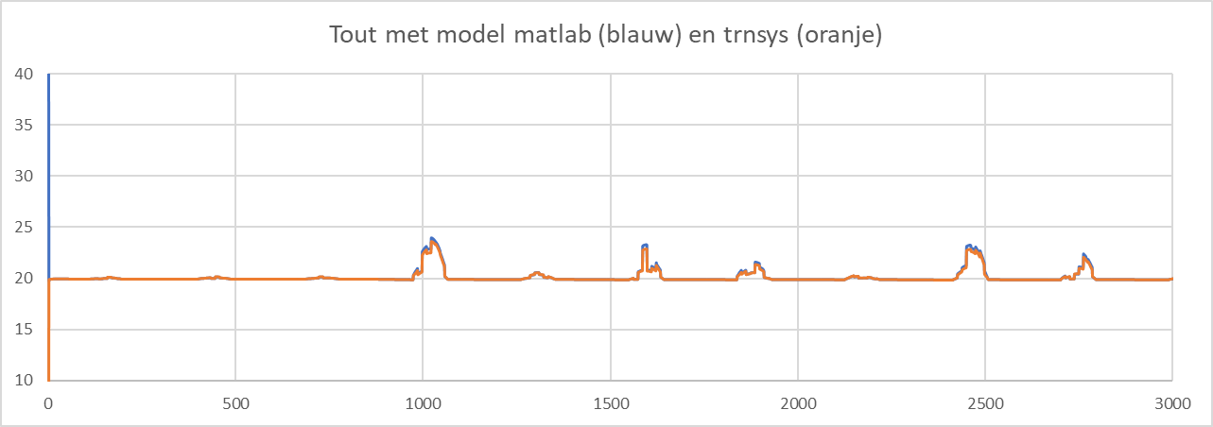
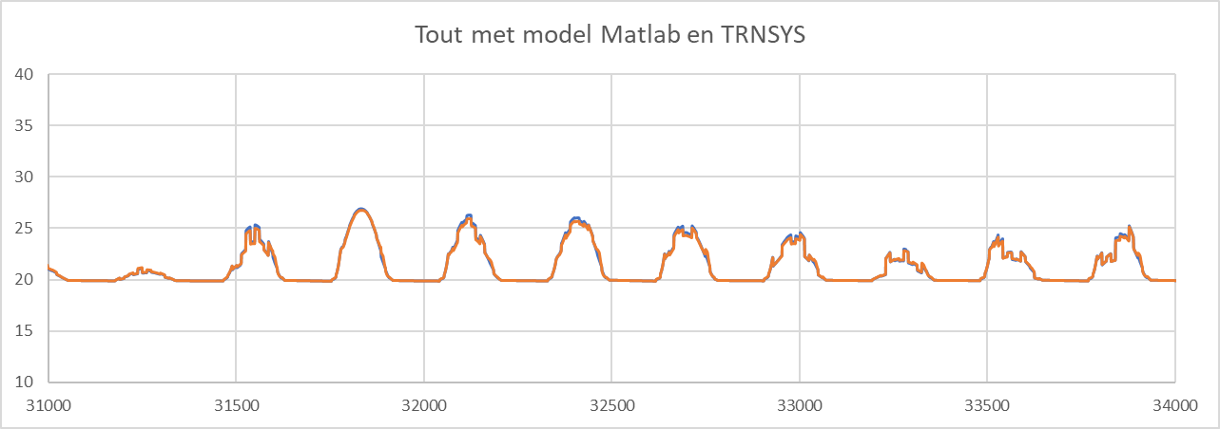
comparison matlab model with trnsys Type1 and 71

Slide 14
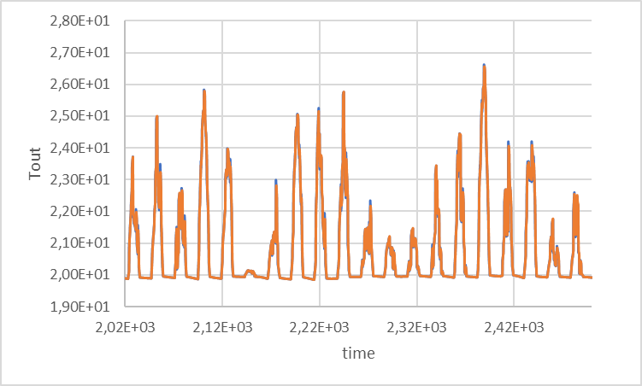
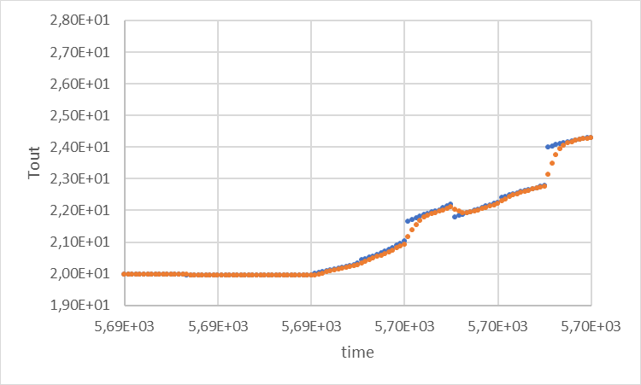
Consider capacitance of collector (TRNSYS)?
TRNSYS model Type71 and 538 are similar models for evacuated tube solar collector, both with quadratic efficiency curve and bi-axial incidence angle modifiers, but only in Type538 the capacitance of the collector may be accounted for.
Results for the same (single) collector:

Slide 15
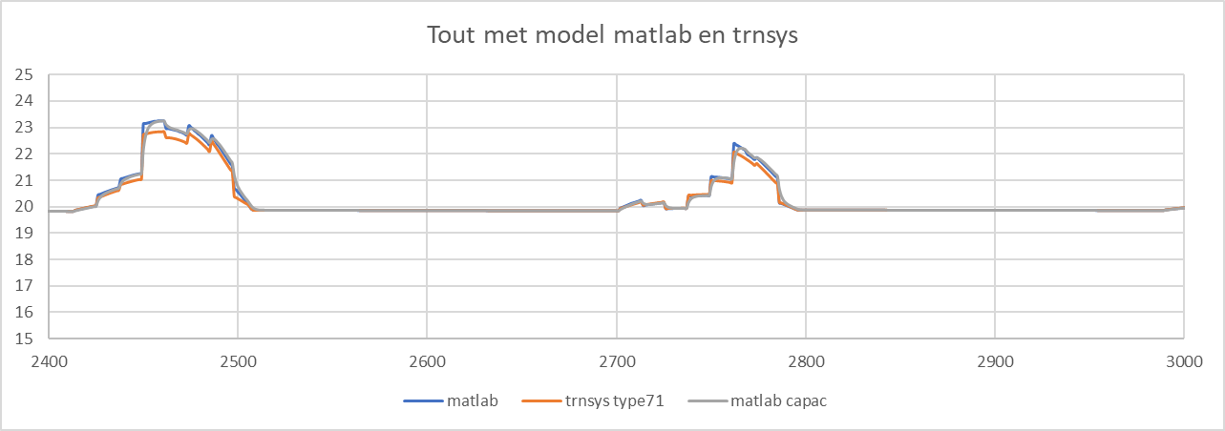
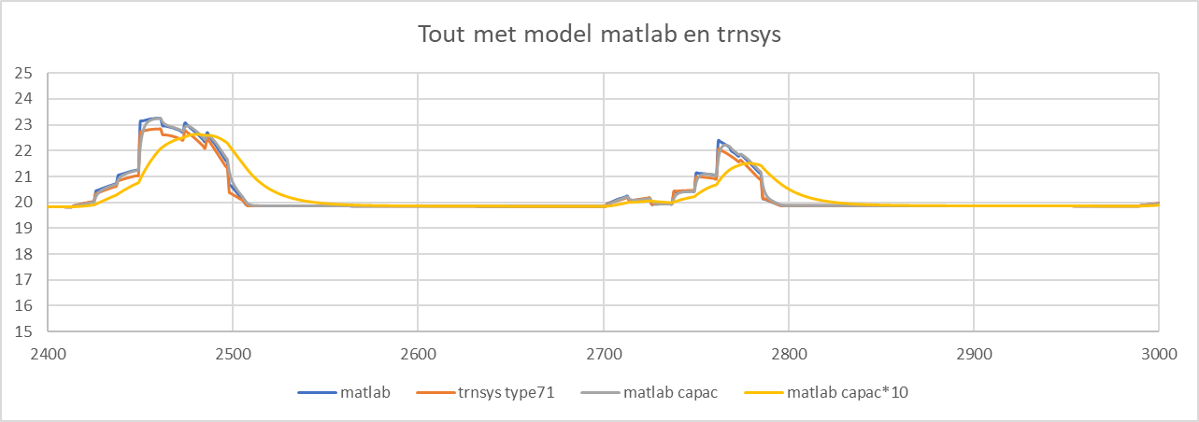
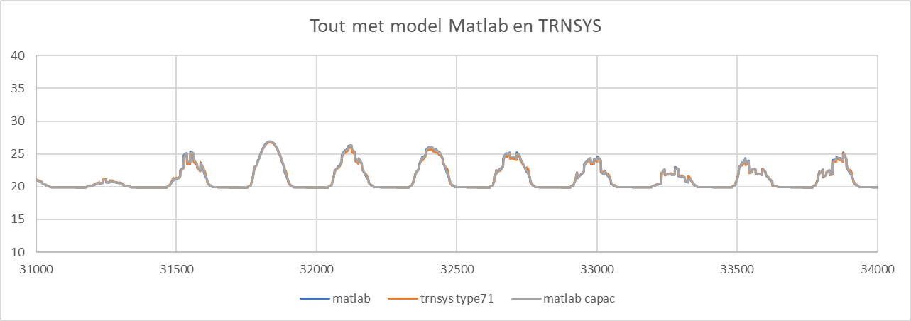
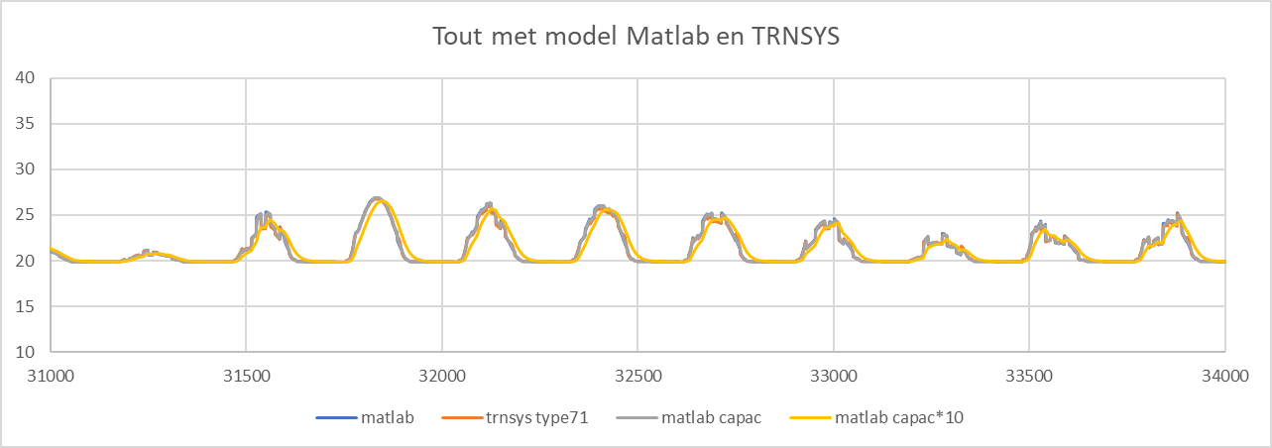
capacitance of collector (Matlab)?
Results for the same (single) collector, flow=testflow: collector capacitance *10, flow=testflow:

Slide 16
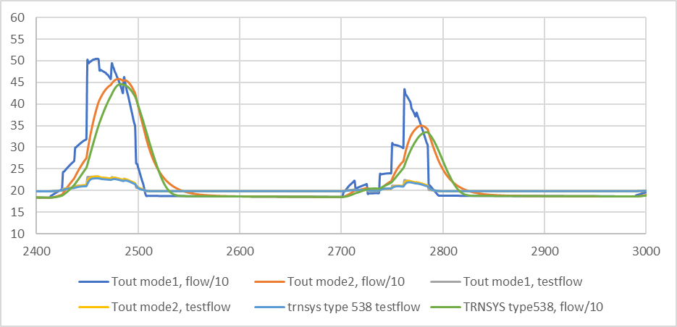
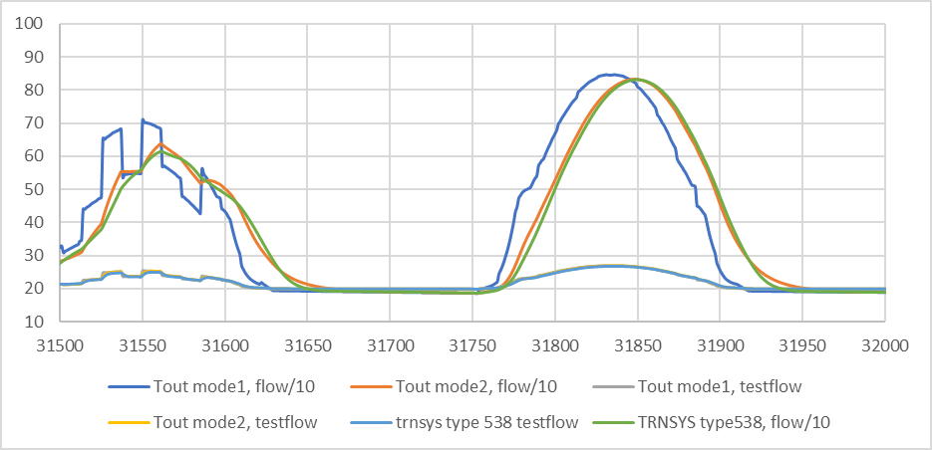
capacitance of collector (Matlab)? Is it problem to work with FR instead of F’ -> impact for different flows (cf F’’ depends on flow)
Results for the same (single) collector, flow=testflow/10:

Slide 17
Better to use model with capacitance, for control, cf if no capacitance Tout has no meaning if flow=0 (no increase of collector temp)

Slide 18
??
Model with capacitance should be with F’ instead of FR, but this wil cause extra loops in calculation and not bring in much…
Collectors in series: correction of FR is possible (or run model for 1 collector multiple times?)
Control? (flow rate constant?)
Serie or parallel?

Slide 19
Validation 2: energy balance

Slide 20
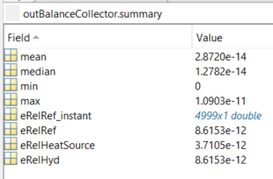
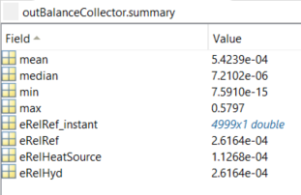
Energy balance for steady state model with constant mass flow (for first 17 days of year)
Of course, if energy balance is verified with Qloss
based on Tout_new (actual timestep),
errors become greater
Qloss is calculated with Tout of previous timestep
(in calculation of Tout_new as well as in energy balance):
-> This shows that calculation of energy balance (without storage) is ok

Slide 21
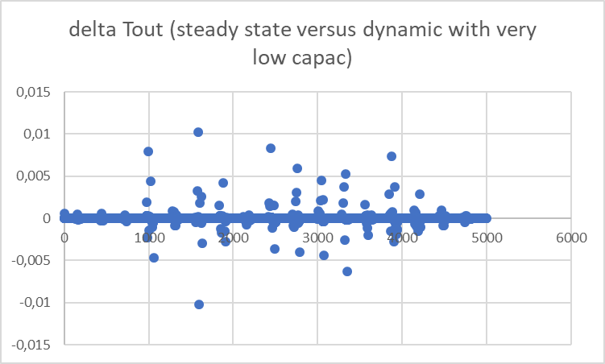
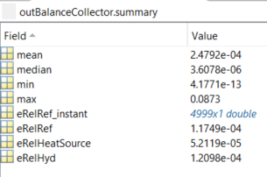
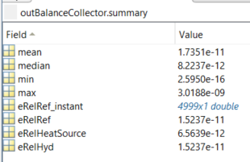
Dynamic simulation with constant mass flow, and C->0
approximation of steady state analysis
Tout corresponds well to steady state calculation, cf absolute error
But error energy balance is remarkable greater than for steady state calculation -> indeed, Tout_mean = (Tout+Tout_new)/2 is not a good approximation in nearly station. case -> for Tout_mean=T_out_new, errors are smaller!
Tout_mean=(Tout+Tout_new)/2:
Tout_mean=Tout_new:

Slide 22
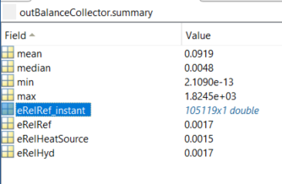
Dynamic simulation with constant mass flow
Errors are related to approximation for Tout_mean
Check error over whole summer
Is it necessary to change calculation of Tout_mean?
What if on/off control is added?
Error dynamic model with lineair approximation of Tout:

Slide 23
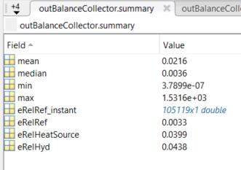
Dynamic simulation with constant mass flow
Error dynamic model with lineair approximation of Tout, 1 year:
With exponential approximation
This is with inHyd based on T_out instead of T_out_mean

Slide 24
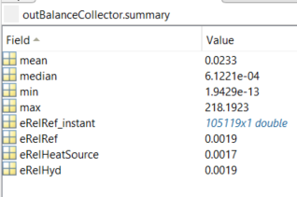
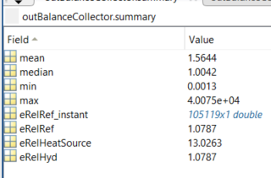
Dynamic simulation with constant mass flow
Error dynamic model with lineair approximation of Tout for losses and inHyd, 1 year:
With exponential approximation for losses and inHyd
Lineair approximation is better than expon??

Slide 25
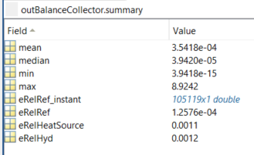
Dynamic simulation with constant mass flow
Error dynamic model with lineair approximation of Tout for losses and inHyd, 1 year:
With max solar gains (to collector) as reference value (instead of net energy gain of collector fluid in each timestep)

Slide 26
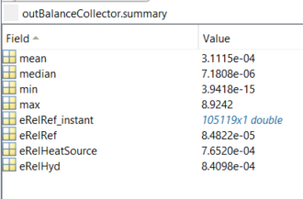
Dynamic simulation with constant mass flow
With max solar gains (to collector) as reference value (instead of net energy gain of collector fluid in each timestep)
With corrected (??) lineair approximation for DT_0 < 5

Slide 27
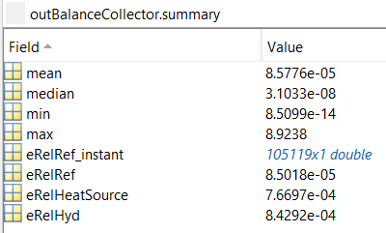
Dynamic simulation with constant mass flow
With corrected (??) lineair approximation for DT_0 < 5
And with approximation for DT_mean in previous value (value at beginning of timestep) instead of new value (at the end of timestep) -> should be better in case DT_0<5 because approx there is also in previous value

Slide 28
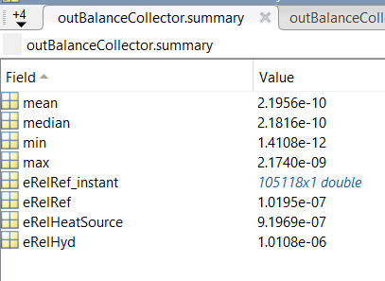
Dynamic simulation with constant mass flow
And with approximation for DT_mean in previous value (value at beginning of timestep) instead of new value (at the end of timestep) -> should be better in case DT_0<5 because approx there is also in previous value
With always lineair approximation of losses, independent of DT_0 (so errors on energy balance should be small)
These will be errors, biggest error
due to approximation of DT as exponential curve, cf
OK!

Slide 30
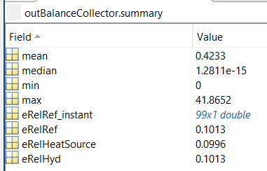
Is approximation of Tout_mean the problem?
Simulation with constant conditions and Tamb=Tcoll_i-1:
Qsolrad=1203W, Tin = 20°C, mdot=0,0456kg/s
Errors in first timesteps (evolution to steady state) great, but going to 10-18 in steady state
See next slide

Slide 31
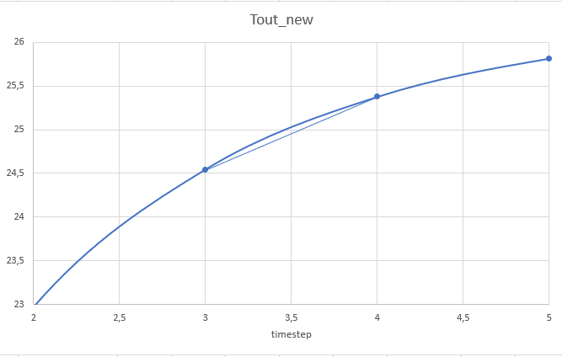
Is approximation of Tout_mean the problem?
For instance timestep 4: Tout_mean (in Qdot) is 24,96°C if lineair approximation, but according to graph 25,008 is better value, and indeed brings error near zero (Qdotloss is very low, influence on Qdotloss is neglected)

